Slide 1
Optical communications and data networks (EENGM2001)
Siddarth K Joshi

Slide 2
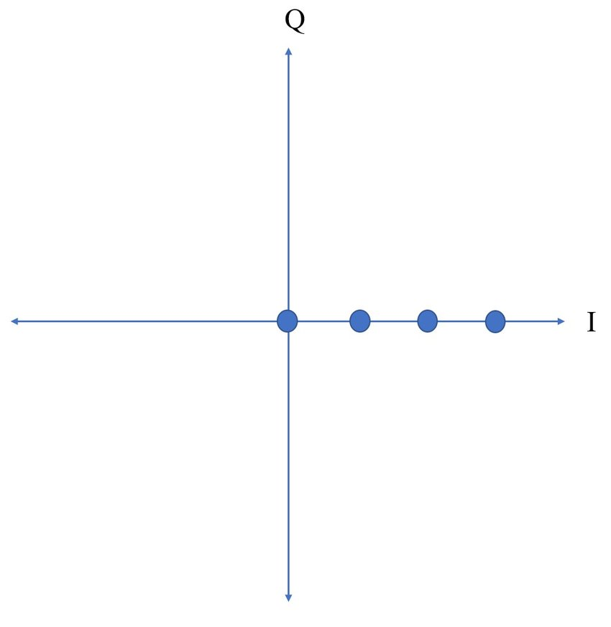
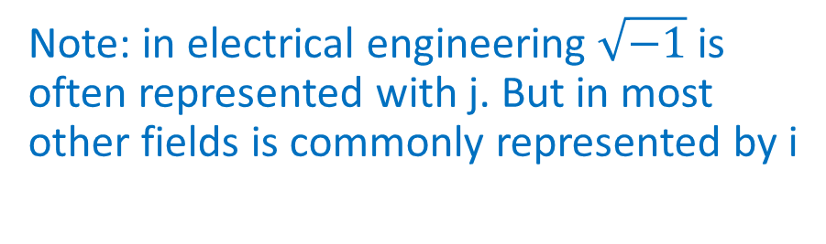
Constellation diagrams
Im(E)
Optical field E=E₀exp(jΦ)
Note: in electrical engineering $\sqrt{−1}$is often represented with j. But in most other fields is commonly represented by i
Phase
Re(E)
4 ASK constellation diagram
Optical ASK is always unipolar!
All symbols have the same phase

Slide 3
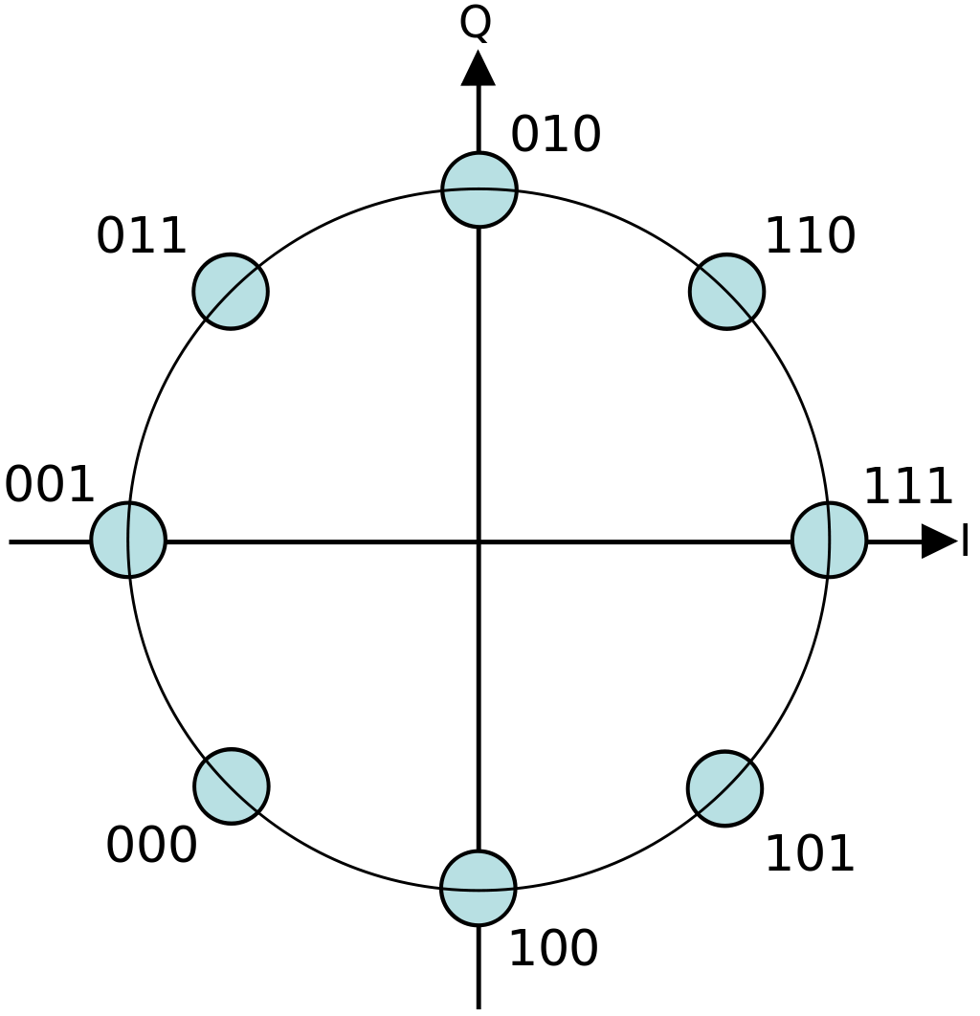
Constellation diagrams
All symbols have equal transmit power!
8PSK constellation diagram

Slide 4
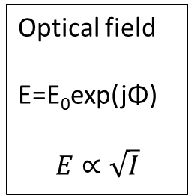
Constellation diagrams
Optical field
E=E₀exp(jΦ)
$$E∝\sqrt{I}$$
E₀
Intensity modulation constellation diagram
Equally spaced in intensity = unequally spaced in amplitude

Slide 5
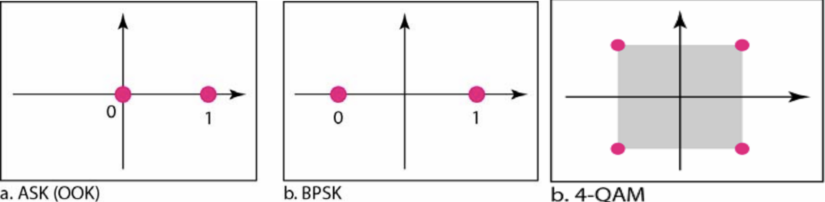
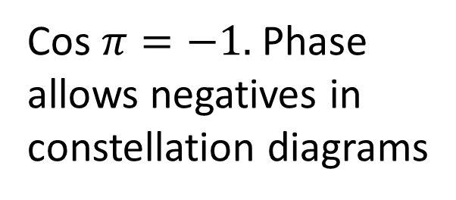
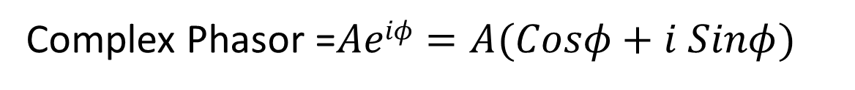
More about constellation diagrams
Complex Phasor =$Aeiφ=A(Cosφ+i Sinφ)$
Cos $π=−1.$Phase allows negatives in constellation diagrams
No negative power

Slide 6
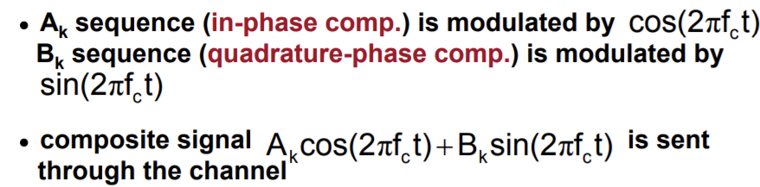
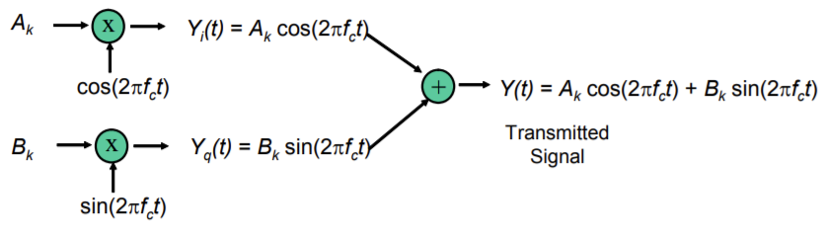
QAM
Split information into two data streams A_{k} and B_{k}
Sin and Cos are 90⁰ out of phase
Mix and transmit
For analogue f_{c} is carrier frequency for us πf_{c} is T – the symbol duration.

Slide 7
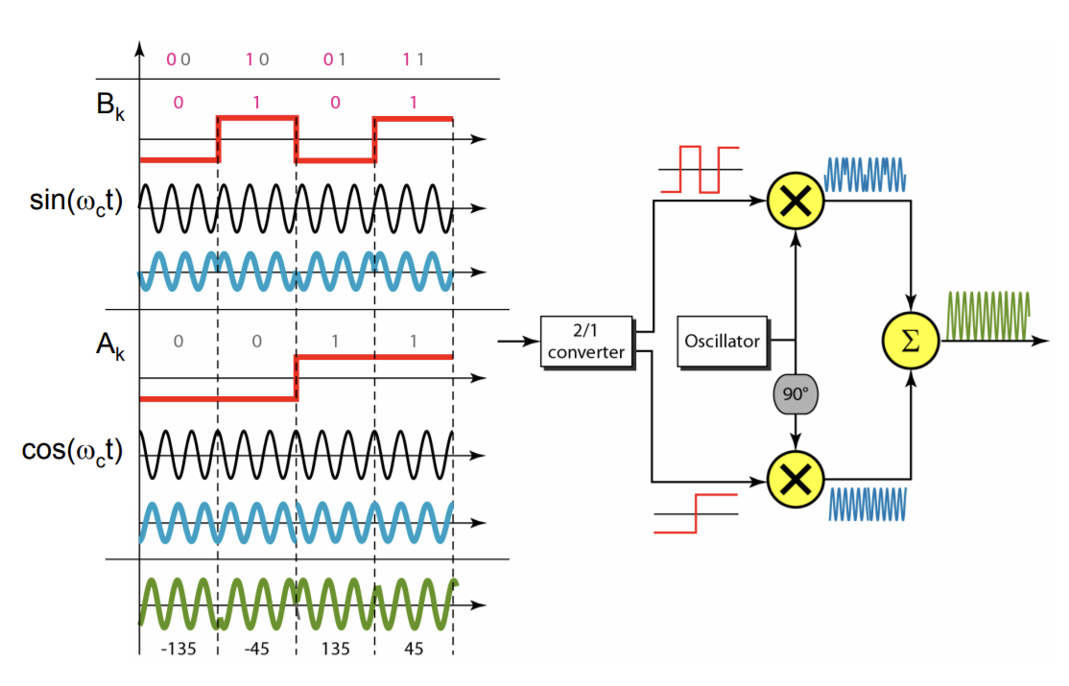
QAM
For optical communication the carrier is split into two phase components and each is amplitude modulated separately

Slide 8
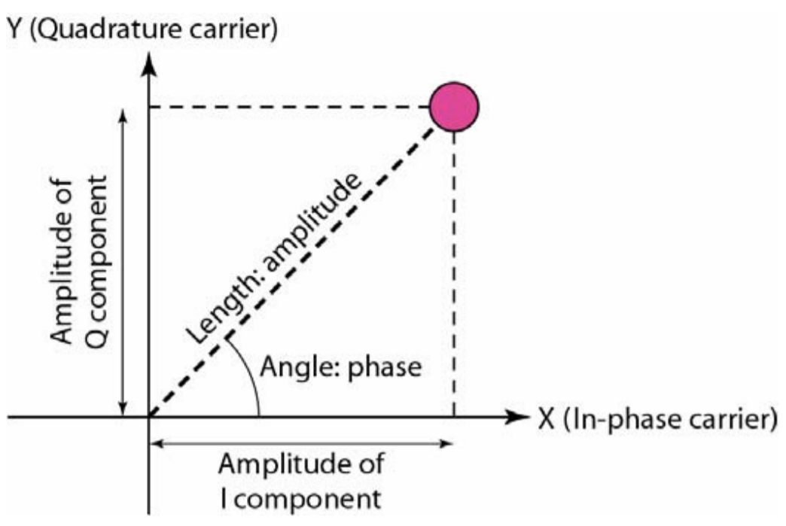
QAM

Slide 9
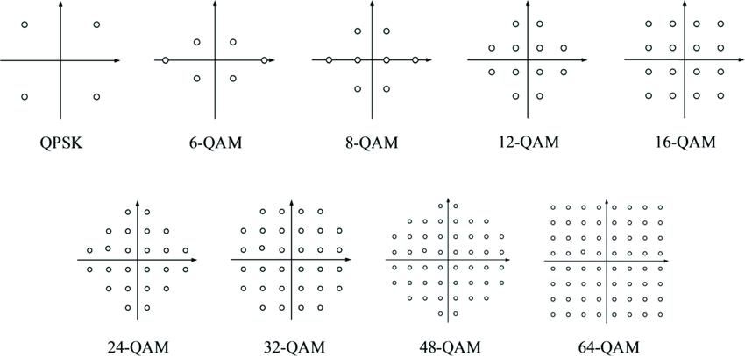
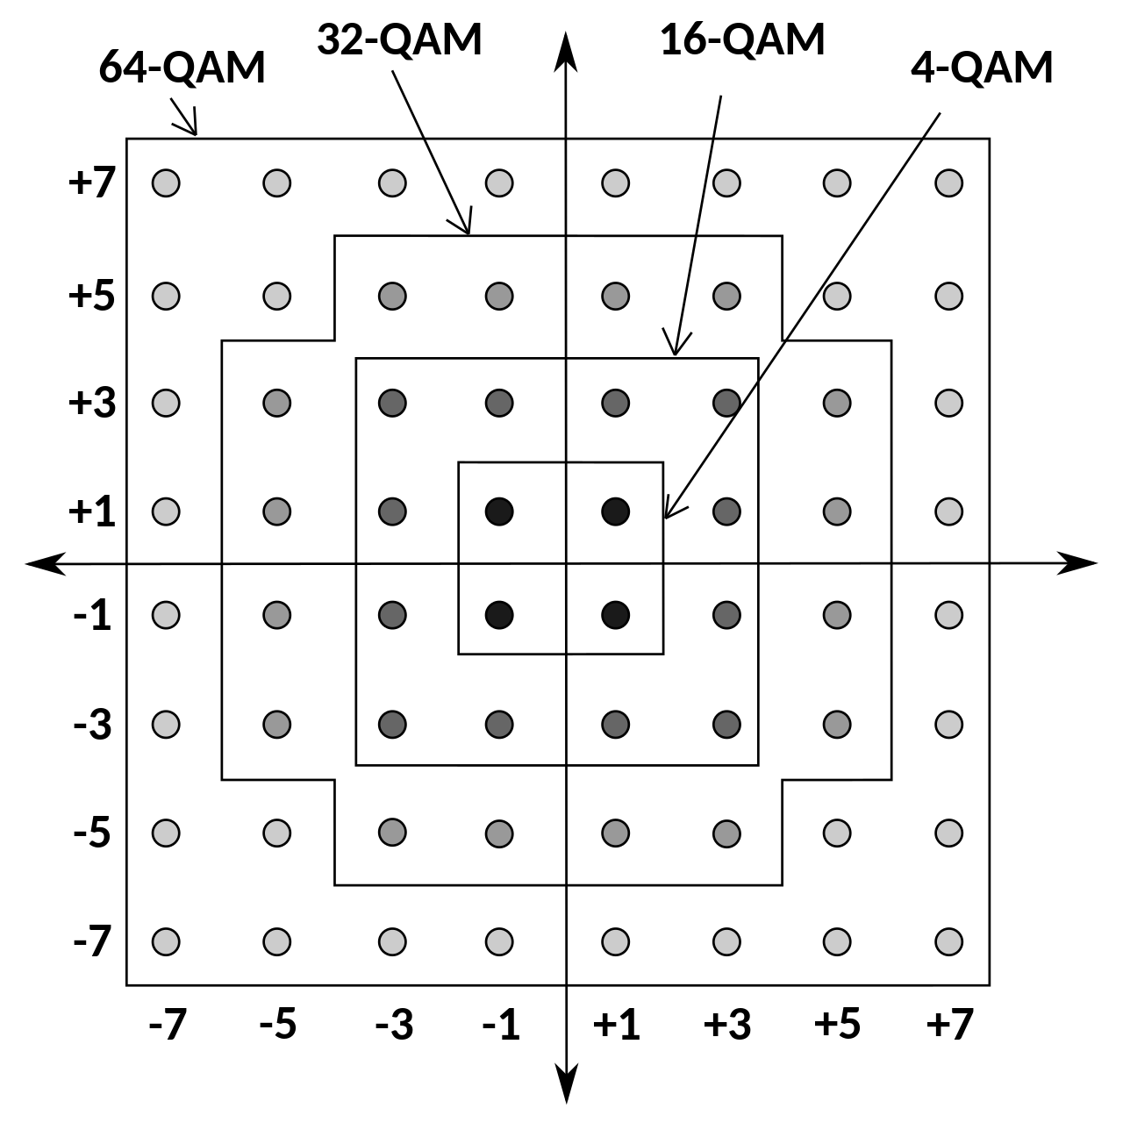
QAM
4QPSK has same constellation diagram as 4QAM

Slide 10
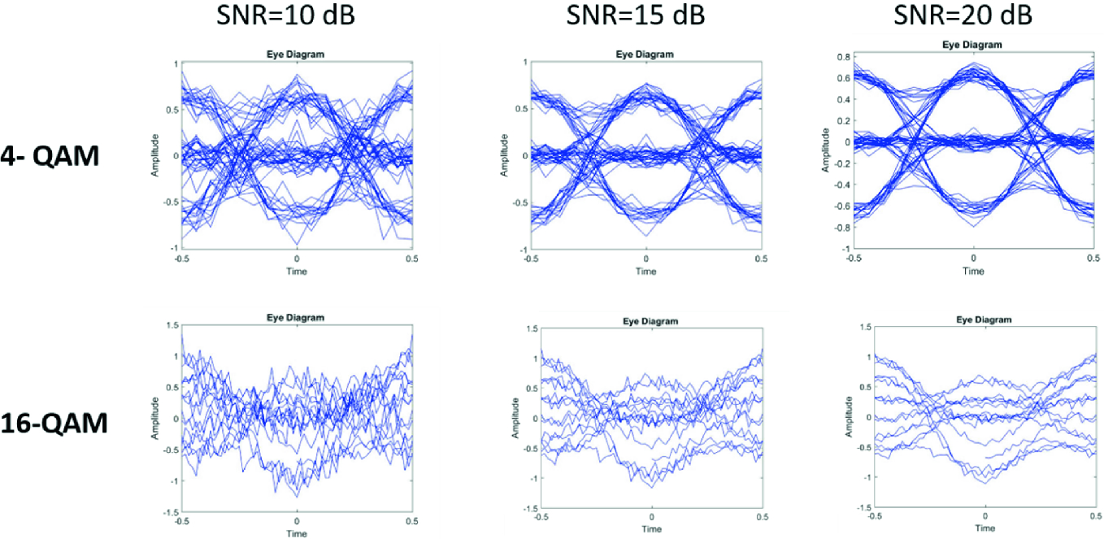
QAM
Ghayal, V.S. and Jeyachitra, R.K., 2020. Efficient Eye Diagram Analyzer for Optical Modulation Format recognition using Deep Learning Technique. In Advances in Electrical and Computer Technologies (pp. 655-666). Springer, Singapore.

Slide 11
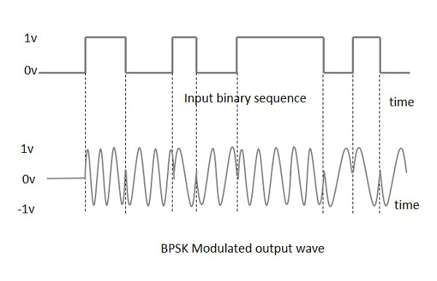
Recap:PSK
Amplitude is affected by noise and loss.
Phase of carrier wave less so.
Binary PSK L = 2 (0 0°, 1 180°)
Less sensitive to noise
Good for long distance and lossy links
Complex signal reconstruction Needs a local oscillator at carrier frequency.
Can you think of this before we discuss it in Week 15?

Slide 12
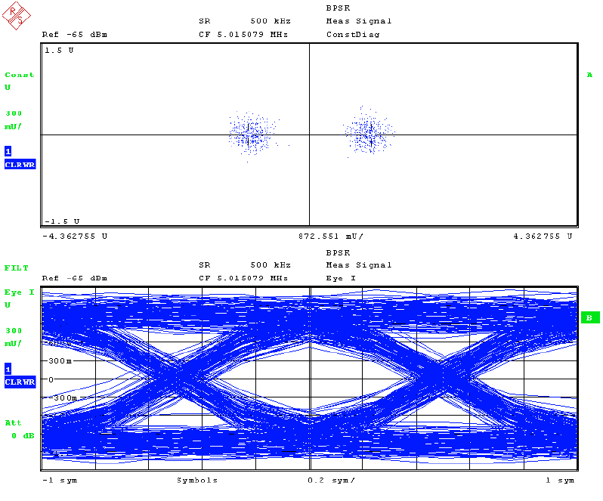
BPSK Eye diagram
Eye diagram is same as NRZ OOK. This is also a “2-state system”. Decoding the phase or the amplitude makes very little difference.

Slide 13
QPSK
Quadrature PSK uses 4 symbols with a 90⁰ phase difference.
Also called 4-PSK
Very similar to 4-QAM
No change in amplitude.

Slide 14
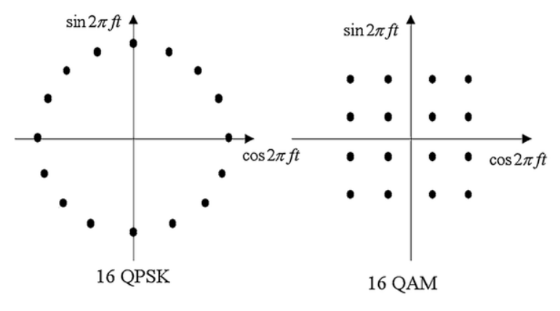
QPSK Vs QAM
BASIS FOR COMPARISON | QAM | QPSK
Stands for | Quadrature Amplitude Modulation | Quadrature Phase-Shift Keying
Spectral width | Narrow | Wide
Number of transmitted bits | Depends on its type | 2 bits
Performance | Average | Better
Bit error rate | High | Low

Slide 15
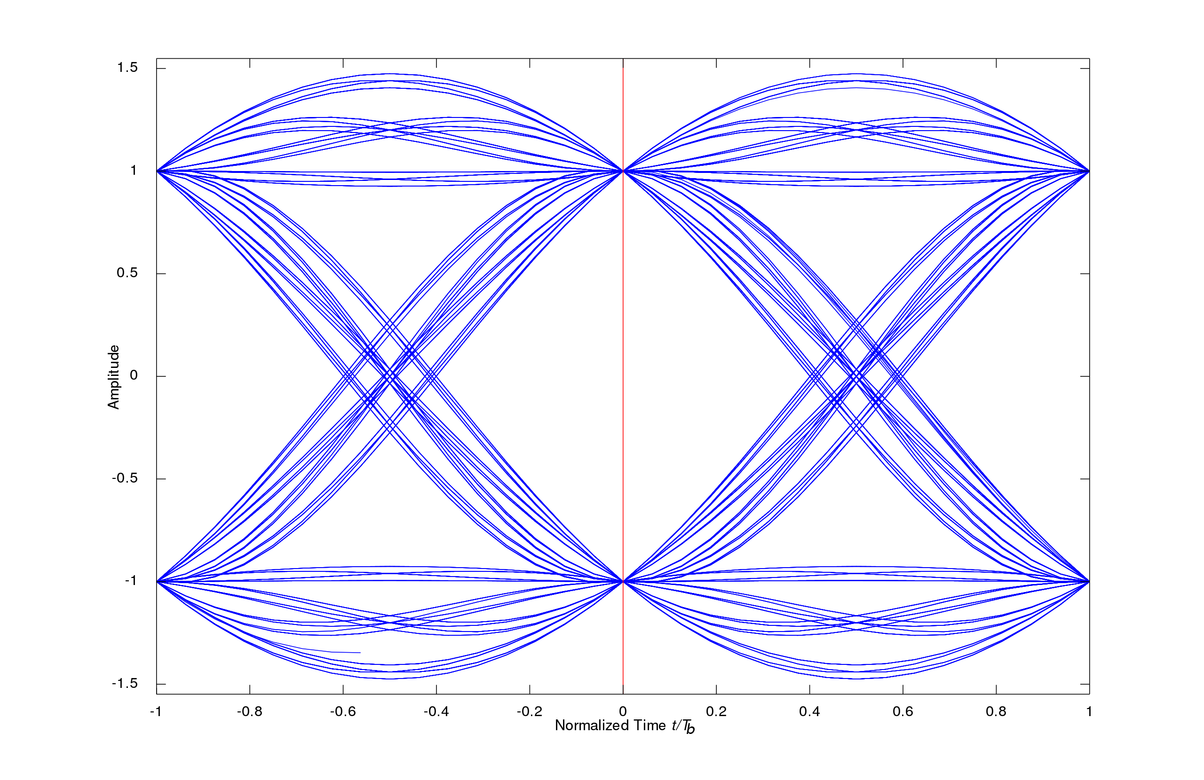
QPSK Eye diagrams
Not the same as 4-QAM,
In 4-QAM we have phase and amplitude change.
In QPSK there is just phase change.
Notes:
High frequency loss.

Slide 16
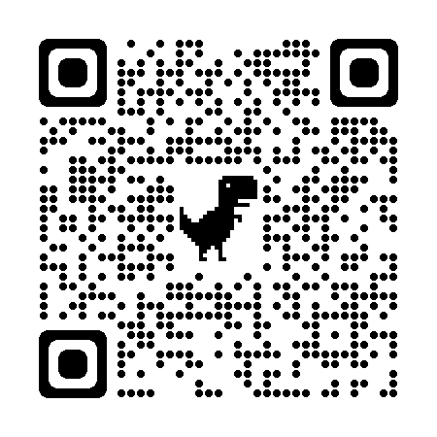
Recommended Reading
Agalliu, Rajdi, and Michal Lucki. "Benefits and limits of modulation formats for optical communications." Advances in Electrical and Electronic Engineering 12.2 (2014): 160-167.
https://core.ac.uk/download/pdf/84392529.pdf

Slide 17
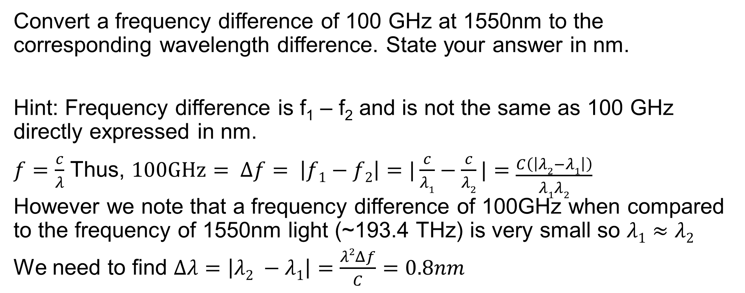
Problem
Convert a frequency difference of 100 GHz at 1550nm to the corresponding wavelength difference. State your answer in nm.
Hint: Frequency difference is f₁ – f₂ and is not the same as 100 GHz directly expressed in nm.
$f=\frac{c}{λ}$ Thus, $100GHz= Δf= \left|f1−f2\right|=|\frac{c}{λ1}−\frac{c}{λ2}|=\frac{C\left(\left|λ2−λ1\right|\right)}{λ1λ2}$
However we note that a frequency difference of 100GHz when compared to the frequency of 1550nm light (~193.4 THz) is very small so $λ1≈λ2$
We need to find $Δλ=\left|λ2 −λ1\right|=\frac{λ2Δf}{C}=0.8nm$

Slide 18
Problem
Draw Constellation diagrams for 8ASK, OOK
8 ASK OOK

Slide 19
Problem
Why do we not use 16-PSK or 32-PSK etc? But still use 64-QAM?

Slide 20
Problem
Dual-polarization quadrature phase shift keying (DPQPSK) or dual-polarization QPSK uses two different polarisations each of which are modulated with a QPSK scheme. If the two polarisations are 0⁰ and 45⁰ and the receiver uses a polariser mounted at 22.5⁰ what fraction of each signal will the receiver see?
Is it possible to use a quad-polarisation QPSK scheme with a single monochromatic channel. Explain your answer.

Slide 21
Problem
If the transmitter needs a minimum OMA of 100μW and the maximum transmit power is 3dBm, what is the highest value of x in an x-ASK scheme that this transmitter can support?
Notes:
6451.61 cm^{–1}

Slide 22
Problem
If the transmitter needs a minimum OMA of 100μW and the maximum transmit power is 3dBm, what is the highest value of x in an x-ASK scheme that this transmitter can support?
100 μW = -10dBm, 3dBm ~ 2mW.
2mW/100uW = 20. So we can have 20 amplitude levels.
But does 20-ASK make sense? No. to transmit 4 bits per symbol we need 16-ASK to transmit 5 bits per symbol we need 32-ASK. With just 20 symbols there will be bit combinations we cant transmit. So the highest permissible value of x is 16.
Notes:
6451.61 cm^{–1}

Slide 23
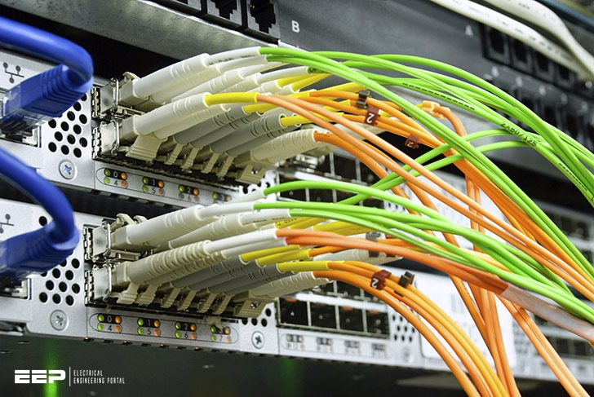
Transmission
Transmitter
Medium
Receiver
Laser/LED
Modulator
Optical Fibre
Free space
Photodiodes
Homo/heterodyne detectors
Optical loss in the medium.
There are many things that can cause errors like:
Loss, dispersion, background noise, birefringence, etc.
Today we only consider loss.
Notes:
6451.61 cm^{–1}

Slide 24
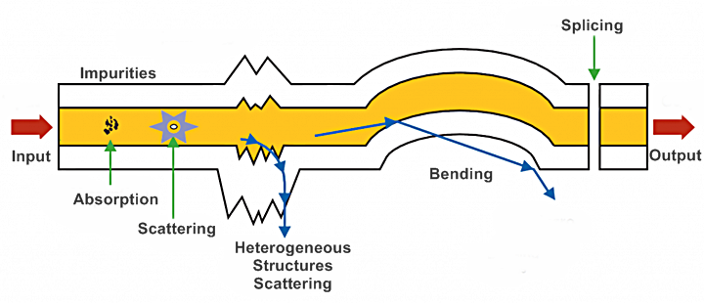
Fibre losses
Notes:
6451.61 cm^{–1}

Slide 25
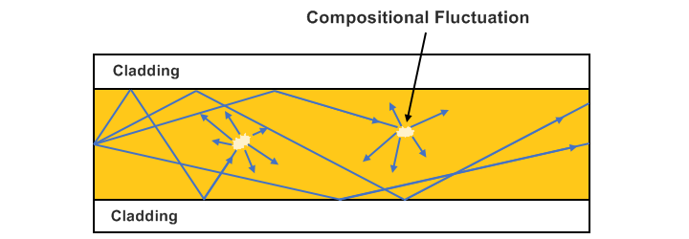
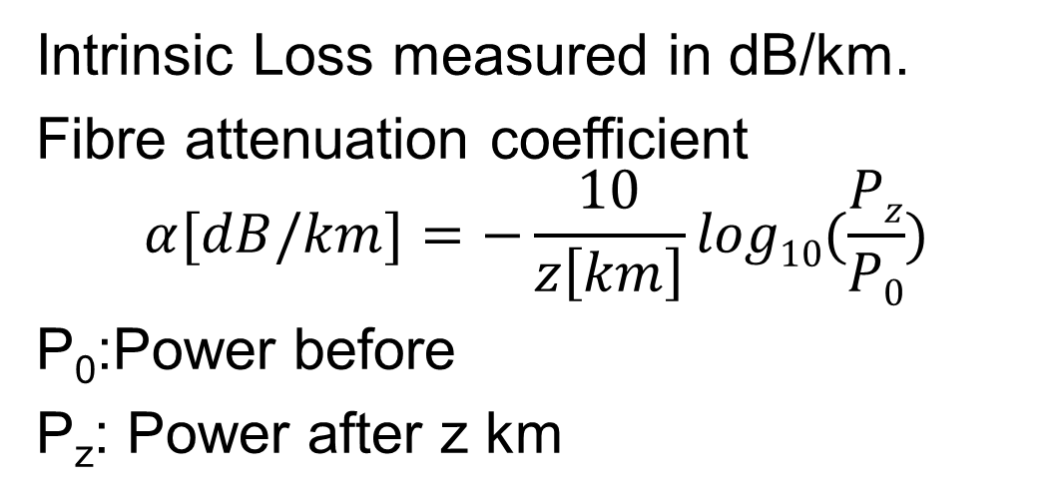
Fibre losses
Intrinsic Loss:
Absorption
Scattering
Intrinsic Loss measured in dB/km.
Fibre attenuation coefficient
$$α[dB/km]=−\frac{10}{z\left[km\right]}log10(\frac{Pz}{P0})$$
P₀:Power before
P_{z}: Power after z km
Attenuation (dB/km)
Wavelength (μm)

Slide 26
Fibre losses
Absorption:
Intrinsic: due to the material itself
Extrinsic: due to impurities
Avoiding impurities is a major challenge.
Hydrogen reacts with the fibre to create OH⁻ ions. Protective coating helps.
Impurity Ion | Loss due to 1ppm of impurity (dB/km) | Absorption Peak Wavelength (um)
Fe²⁺ | 0.68 | 1.1
Fe²⁺ | 0.15 | 0.4
Cu²⁺ | 1.1 | 0.85
Cr³⁺ | 1.6 | 0.625
V⁴⁺ | 2.7 | 0.725
OH– | 1.0 | 0.95
OH– | 2.0 | 1.24
OH– | 4.0 | 1.38

Slide 27
Fibre losses
Scattering:
Rayleigh
Brillouin
Stimulated Raman

Slide 28
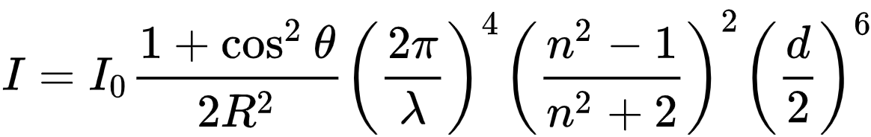
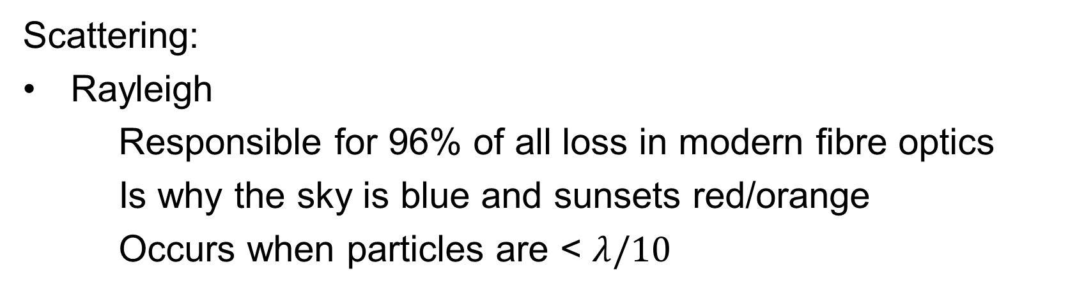
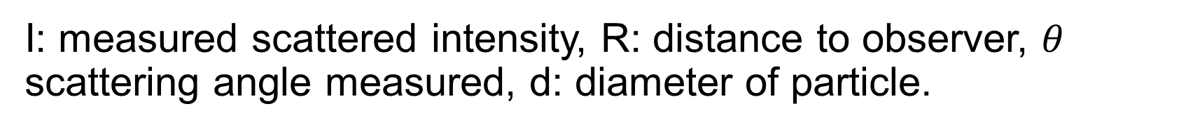
Fibre losses
Scattering:
Rayleigh
Responsible for 96% of all loss in modern fibre optics
Is why the sky is blue and sunsets red/orange
Occurs when particles are < $λ/10$
I: measured scattered intensity, R: distance to observer, $θ$ scattering angle measured, d: diameter of particle.

Slide 29
Fibre losses
This is a linear process!
Strong dependence on wavelength and particle size
Scattering:
Rayleigh
Responsible for 96% of all loss in modern fibre optics
Is why the sky is blue and sunsets red/orange
Occurs when particles are < $λ/10$
I: measured scattered intensity, R: distance to observer, $θ$ scattering angle measured, d: diameter of particle.

Slide 30
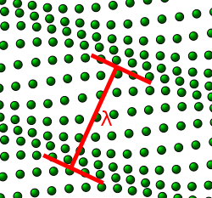
Fibre losses
Brillouin Scattering:
Non linear process
Photon interacts with small inhomogeneities in medium
Thermal energies (Phonon), EM wave-dipole interaction (Polariton), or collective spin excitation (Magnon) can be absorbed (anti-Stokes) or created (Stokes)

Slide 31
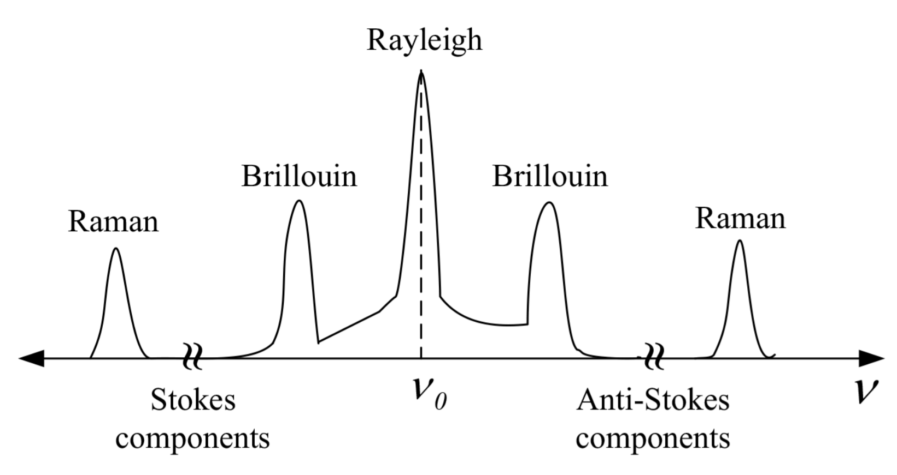
Fibre losses
Brillouin Scattering:
Stokes = Lower energy
Anti-Stokes = higher energy.
Sensitive to temperature and strain.
Used for sensors.

Slide 32
Fibre losses
Brillouin Scattering:
Lower energy Stokes component dominant at low and room temperature
Usually scattered in the backwards direction.
So far we have only talked about spontaneous Brillouin scattering.
There is also stimulated Brillouin scattering.

Slide 33
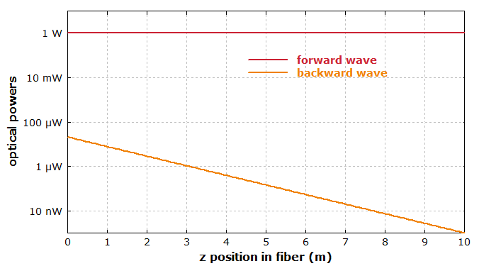
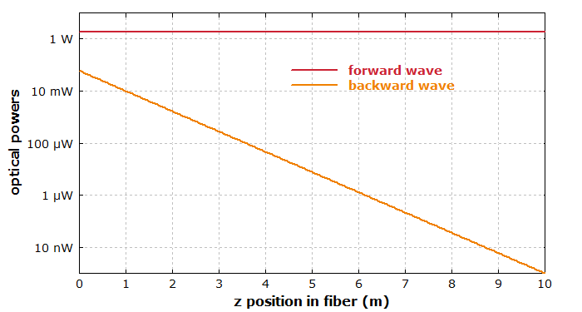
Fibre losses
Stimulated Brillouin Scattering:
10m fibre 1W input
10m fibre 1.8 W input

Slide 34
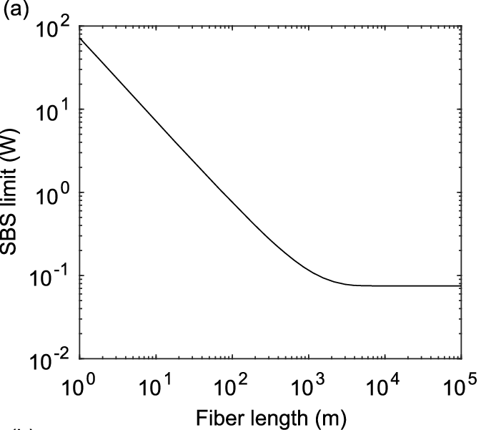
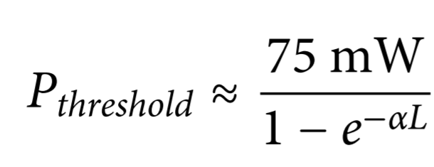
Fibre losses
Stimulated Brillouin Scattering:
Limit on max transmit power!
If you send > 100mW (20dBm) through a long fibre, almost all light will be back scattered.
For a 1% back reflection and standard 100GHz channel.
Thus typical launch powers are < ~5mW.

Slide 35
Problem
Given Stimulated Brillouin Scattering (SBS) occurring in a long single mode telecom fibre, what is the maximum length of fibre that can be used without an amplifier, if the receive power must be at least -30dBm.
Assume that the acceptable threshold is
The loss of the fibre is 0.2dB/km.

Slide 36
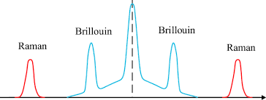
Fibre losses
Scattering:
Stimulated Raman
Interaction with vibrational levels of molecules
Isotropic scattering
If transmitting at multiple wavelengths, adds noise to other channels.
Raman shift is typically ~10 THz.
Brillouin shift is about 10 to 500 GHz

Slide 37
Fibre losses
High transmit power (i.e. >10 mW or 10 dBm) is almost always a bad idea for long distance (i.e. >> 10 km) communication.

Slide 38
Fibre losses
Notes:
6451.61 cm^{–1}

Slide 39
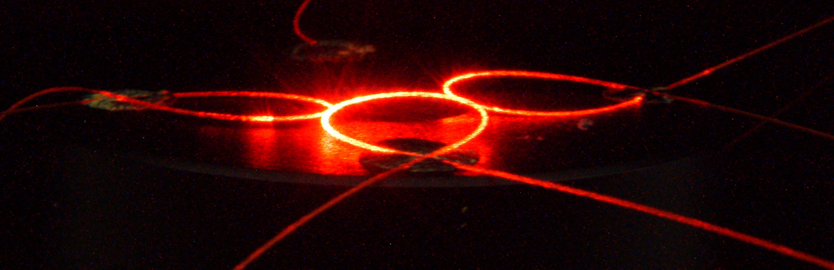
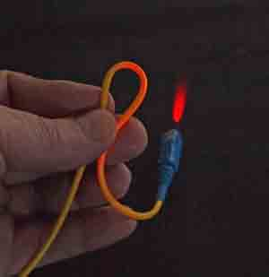
Fibre losses
Bending
Any bend causes strain.
This increases scattering
Data sheets specify different losses at different bend radii

Slide 40
Fibre losses
Insertion loss
Difference in refractive index between fibre and air causes some light to be reflected at a boundary.
Typically ~ -0.2dB
Can be reduced by AR coating (Expensive, delicate)

Slide 41
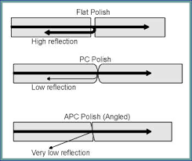
Fibre losses
Return loss
Back reflected light due to connectors/ends
Typically ~ -0.1dB
Can be reduced by AR coating (Expensive, delicate)

Slide 42

Fibre losses
Splicing
Heat, melt and fuse the glass fibres together.
Always some loss, typically
0.3dB.

Slide 43
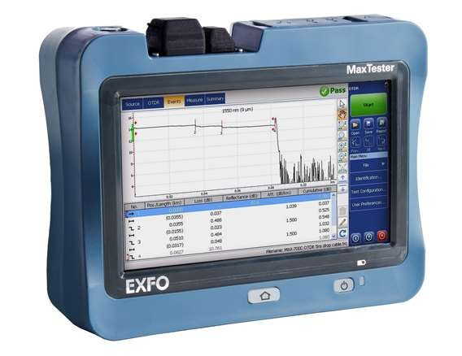
Measuring Fibre losses
Optical Time Domain Reflectrometry (OTDR)
Send pulse of light, measure back reflected pulse.
Use time of flight to measure position.

Slide 44
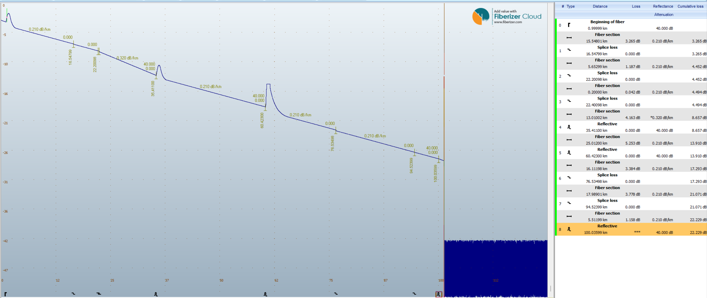
Measuring Fibre losses

Slide 45
Measuring Fibre losses
Reading an OTDR result is a basic skill and an ILO.
You need to be able to identify the total loss, distance to major events, etc.

Slide 46
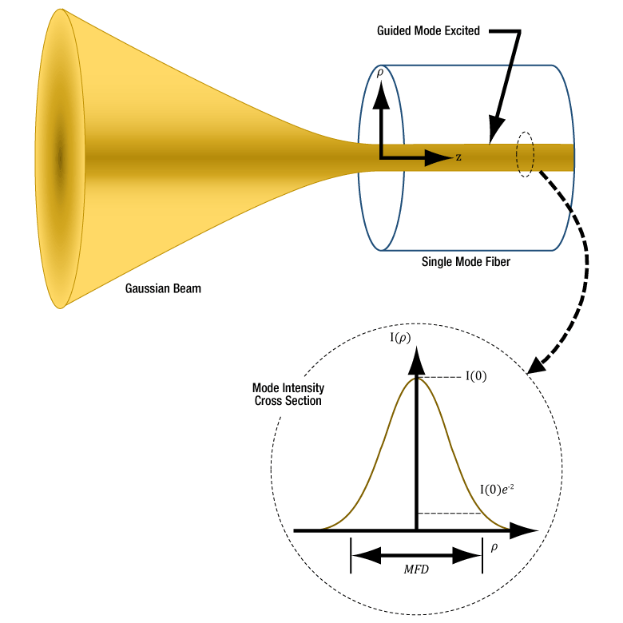
Fibre properties
Mode field diameter (MFD):
For good coupling input beam diameter = MFD
Represents extent of light field in fibre.
MFD > core.
Part of light travels through cladding

Slide 47
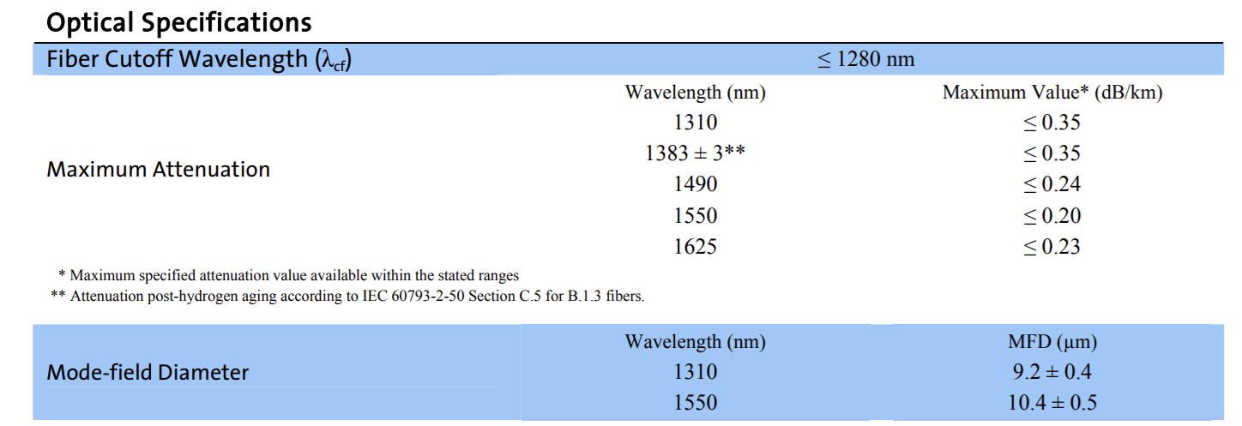
Fibre properties

Slide 48
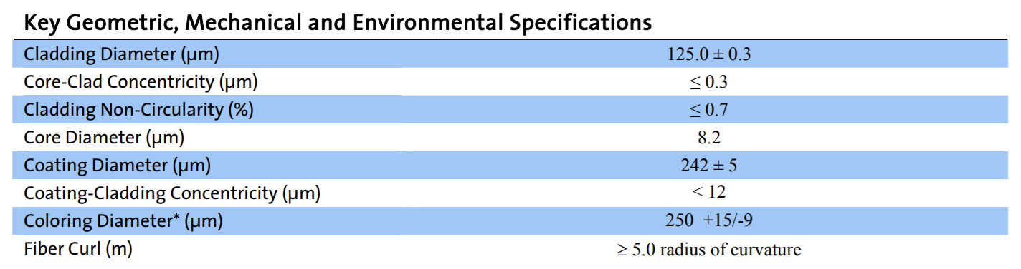
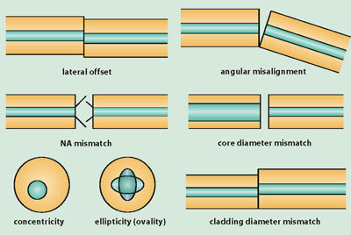
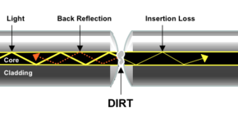
Fibre properties

Slide 49
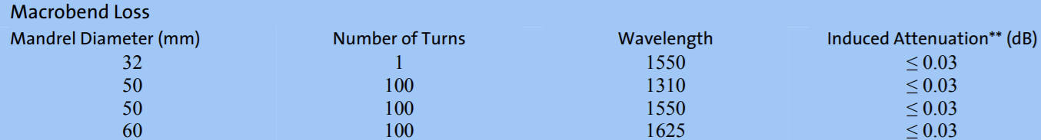
Fibre properties

